Slide 1
EU consumer habits regarding fishery and aquaculture products

Slide 2
METHODOLOGY
Survey conducted face-to-face at respondents’ home
Fieldwork: June 23th to July 06th 2018
Population: Population 15+
Coverage: 28 EU Member States
Number of interviews: 27,734 (Bulgaria: 1,031)

Slide 3
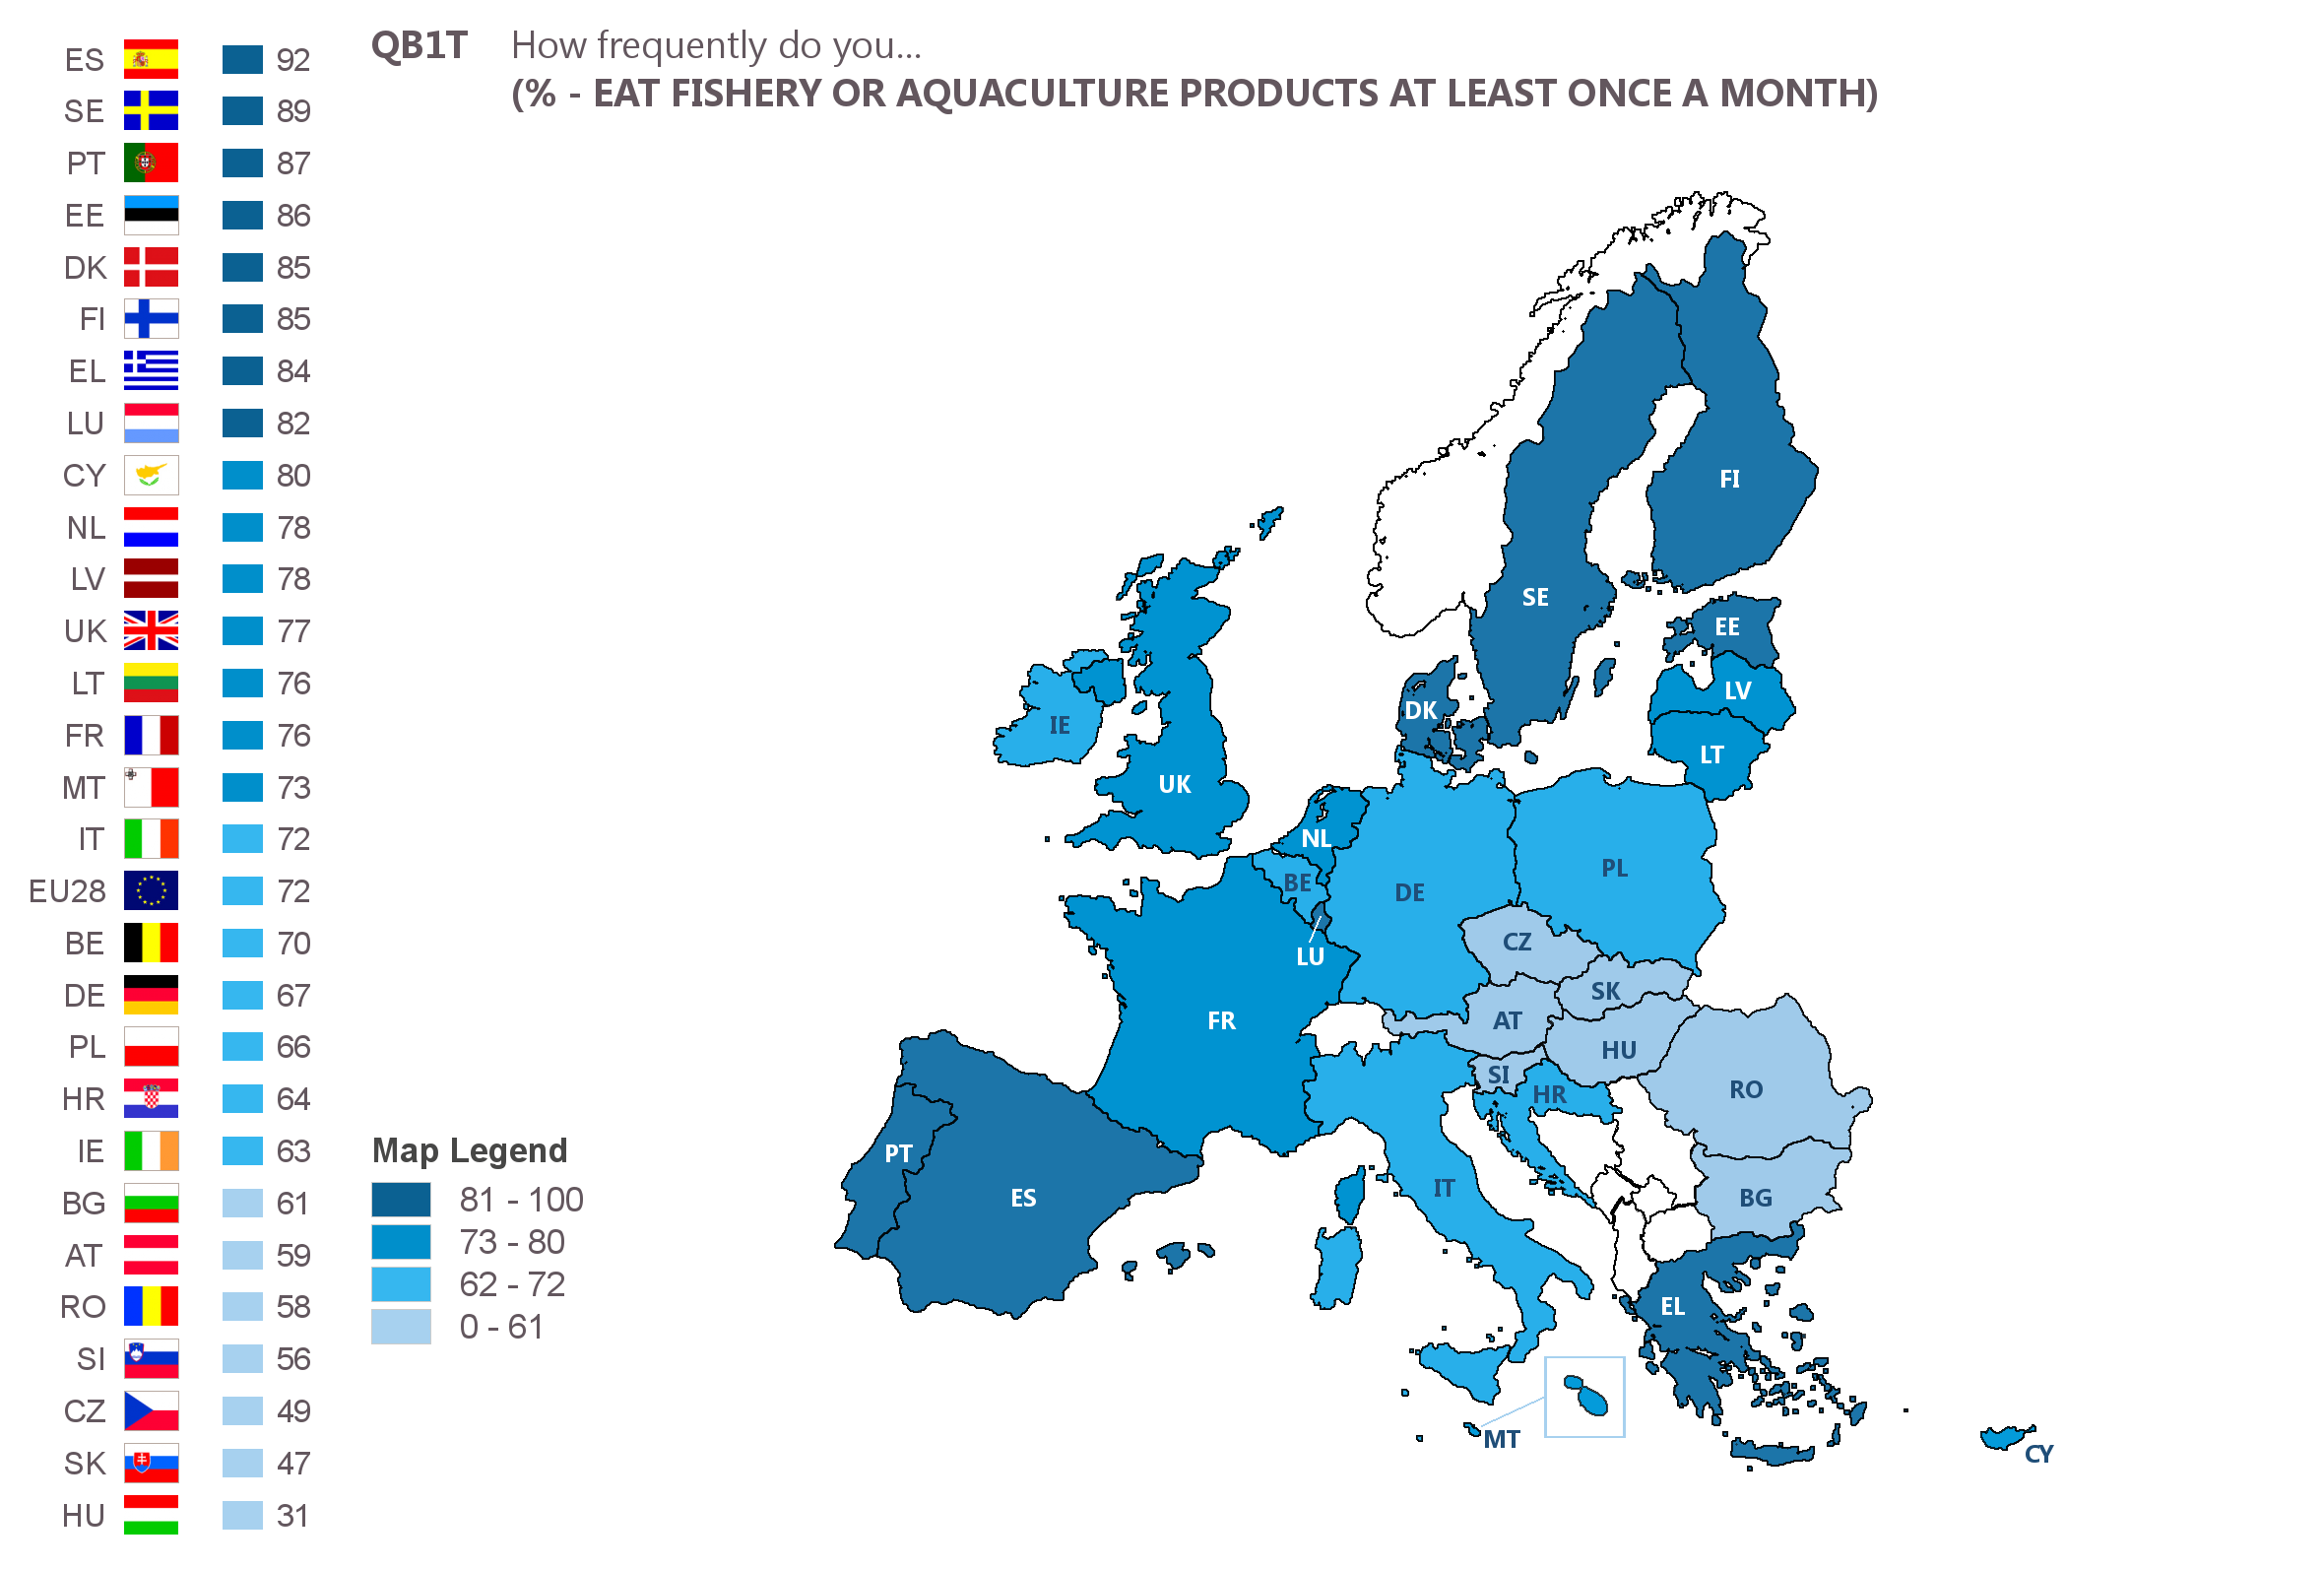
Respondents in land-locked countries are less likely to eat FAPs at least once a month than those in countries with coastlines
 | EU28 | BG
 | 72 | 61
15-24 | 62 | 57
25-39 | 70 | 63
40-54 | 74 | 63
55+ | 76 | 60
Base: all respondents

Slide 4
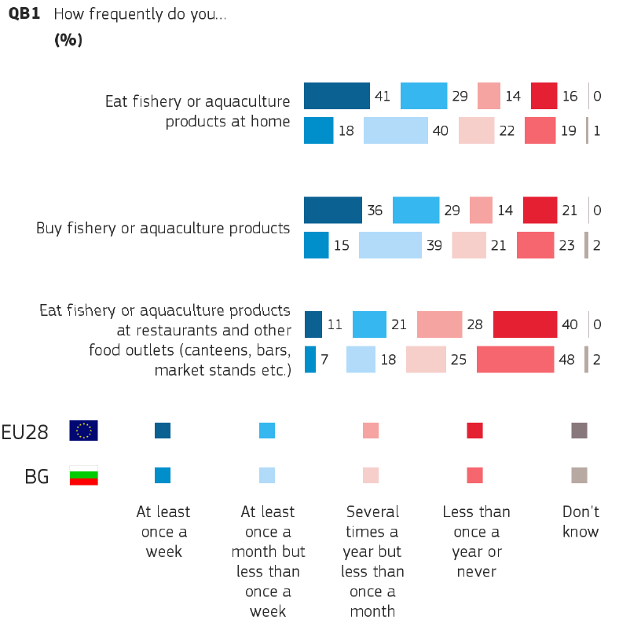






But where?
20 | 22 | 20
35 | 31 | 34
9 | 7 | 6
16 | 16 | 17
Base: all respondents

Slide 5

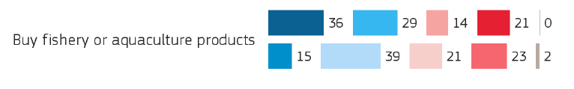
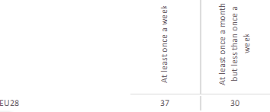
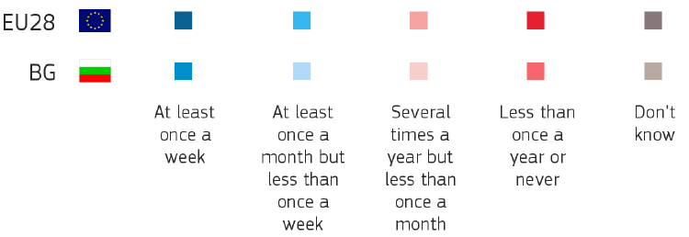
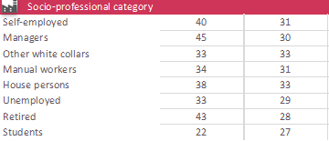
FAP purchase
EU | BG | EU | BG
36 | 15 | 29 | 39
39 | 30 | 33 | 38
45 | 22 | 28 | 45
33 | 16 | 32 | 40
30 | 11 | 31 | 43
40 | 14 | 28 | 34
33 | 14 | 30 | 39
41 | 17 | 29 | 36
20 | 10 | 24 | 27
Base: all respondents

Slide 6
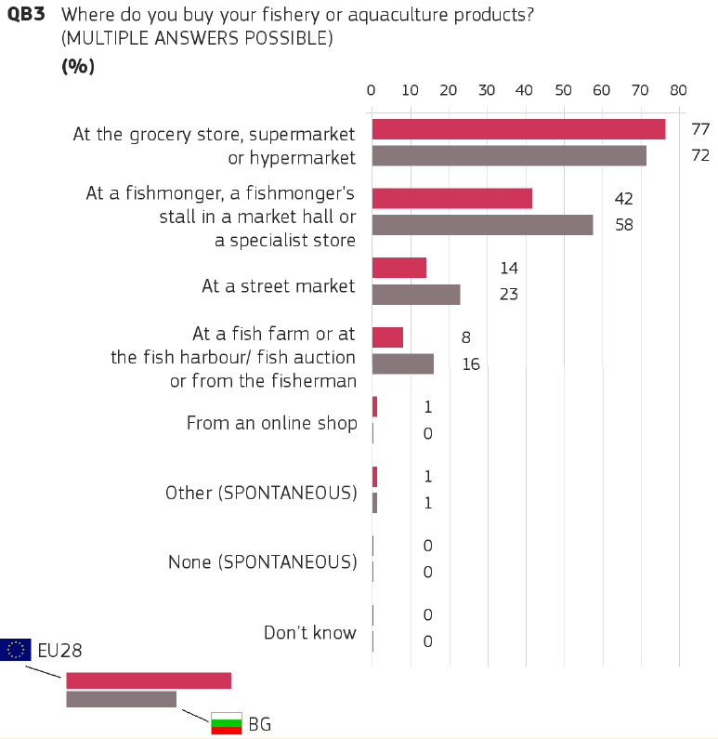
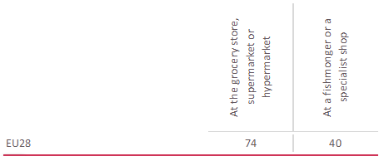
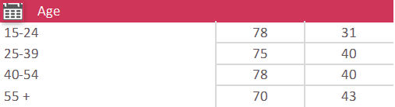
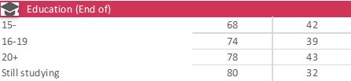
Where do people buy? Mostly at supermarkets (72%)
EU | BG | EU | BG
77 | 72 | 42 | 58
80 | 75 | 34 | 63
81 | 77 | 41 | 60
78 | 66 | 43 | 62
74 | 71 | 44 | 55
Base: respondents who buy fishery or aquaculture products

Slide 7
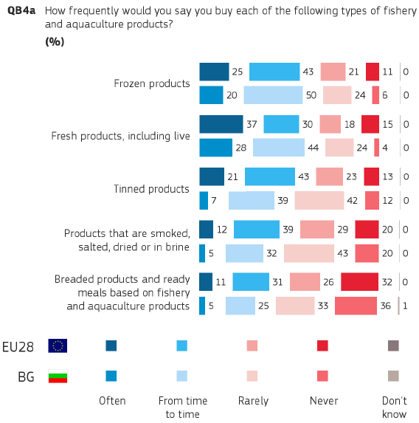
What do people mostly buy
Trend: fresh and convenience / ready-to-eat products
Base: respondents who buy fishery or aquaculture products

Slide 8
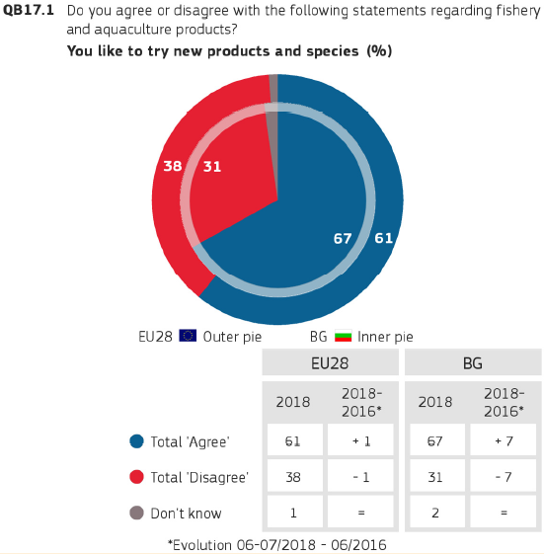
Openness to trying new products and species (67%)
61% (67% in BG)
agree at EU level
71% (77% in BG)
aged 25-39 but also 83% of people aged 35-44
68% (75% in BG)
finished education aged 20+ but 79% of students in BG
67% (78-71% in BG)
Household composition 3+
but also: 94% of house persons
Base: respondents who buy and/or eat fishery or aquaculture products

Slide 9
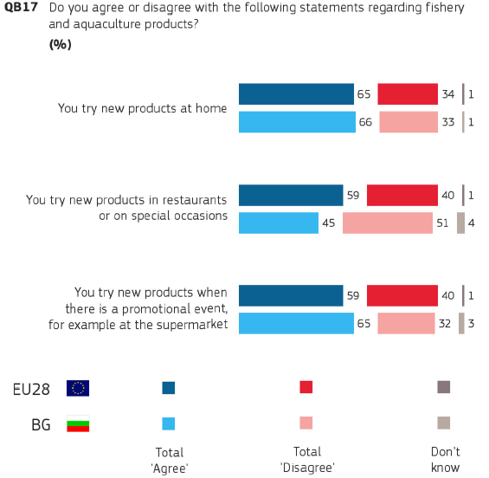


But where?
Base: respondents who buy and/or eat fishery or aquaculture products

Slide 10
Consumers know that FAPs are healthy
QB9 In your opinion, what are the main reasons for buying or eating fishery and aquaculture products?
Base: respondents who buy and/or eat fishery or aquaculture products

Slide 11
Why not eat FAPs
QB2 Which of the following are the main reasons why you never or almost never eat fishery or aquaculture products?
Base: respondents who never eat any fishery or aquaculture products

Slide 12
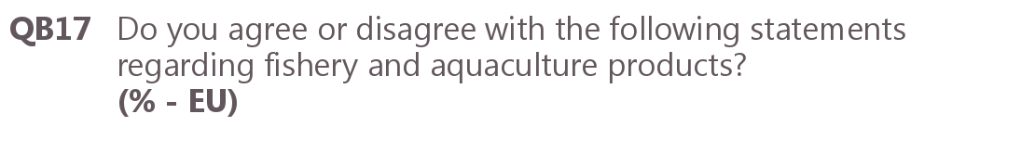
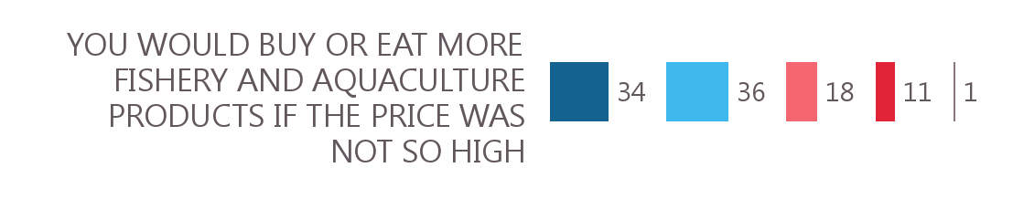
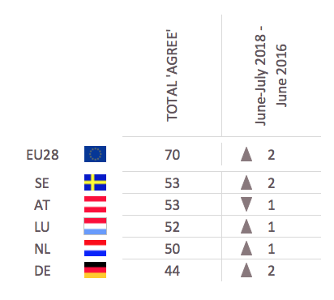

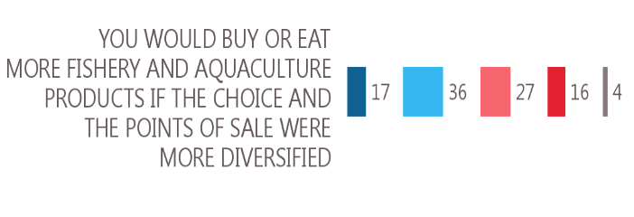
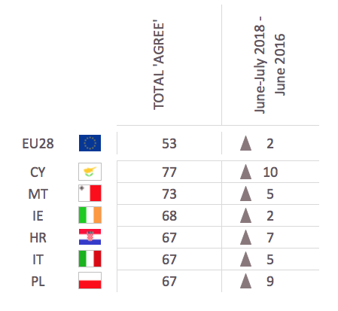
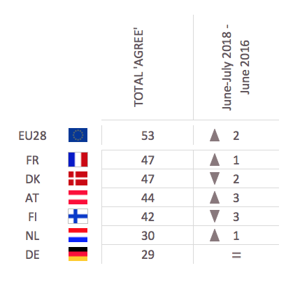
Would you buy more if…?
BOTTOM
TOP
TOP
BOTTOM
BG
66

Slide 13
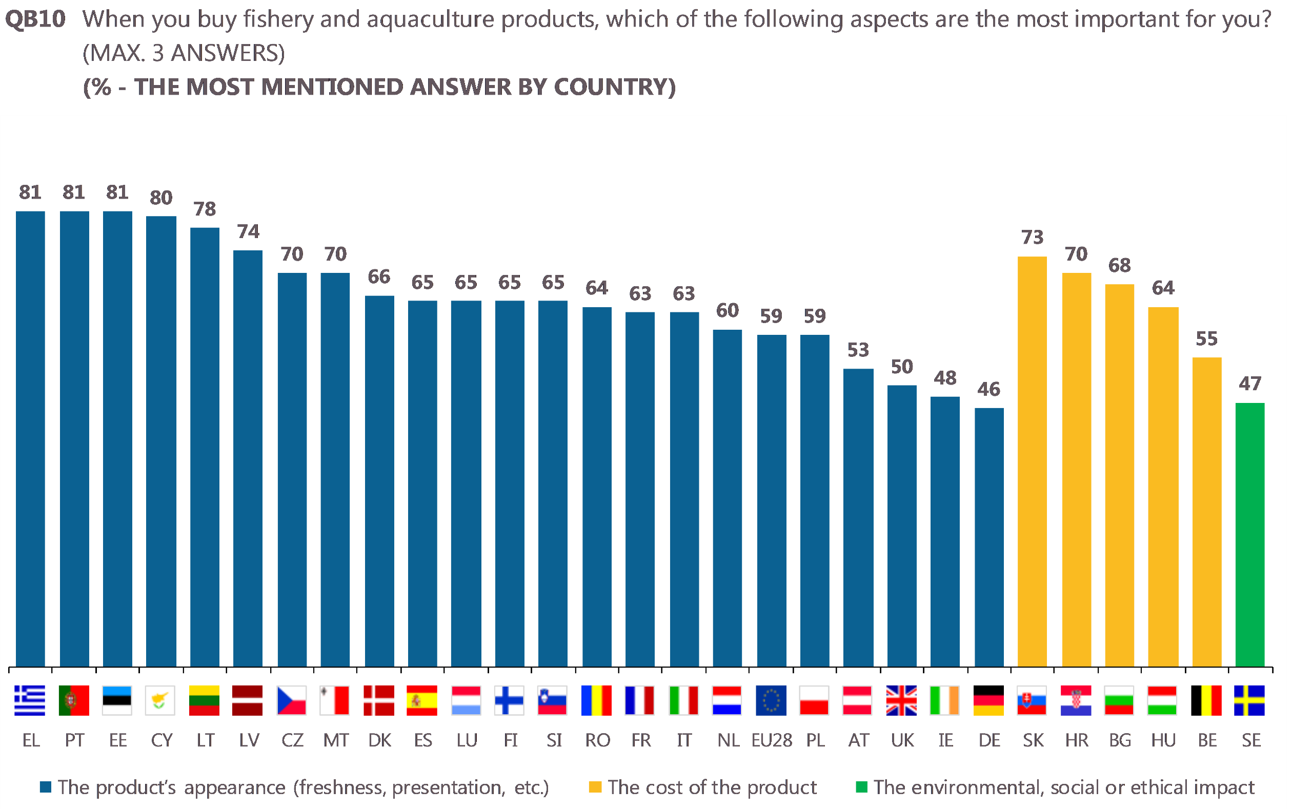
What are the main purchasing factors?
Base: respondents who buy fishery or aquaculture products

Slide 14
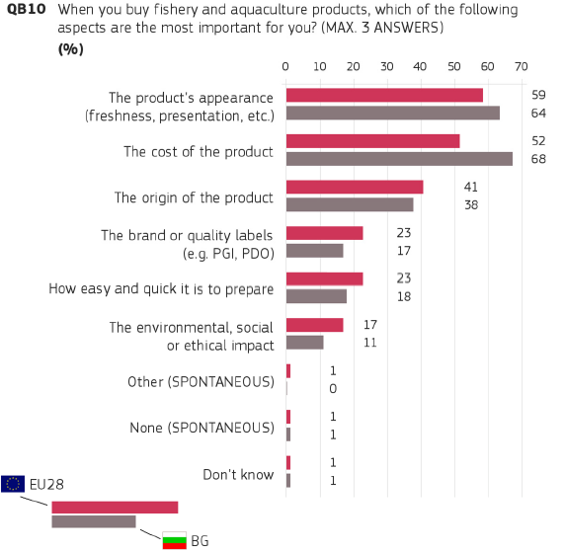
A closer look to the main purchasing factors in Bulgaria:
Base: respondents who buy fishery or aquaculture products
Notes:
In

Slide 15
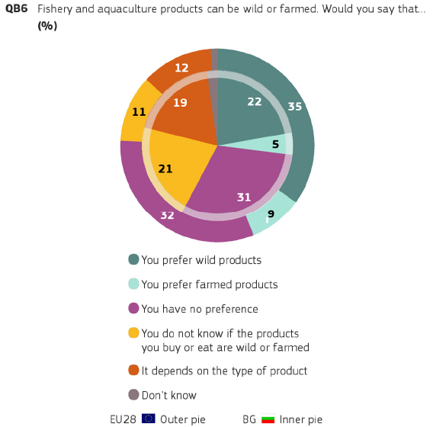
A relative majority of consumers prefer wild products (22%) to farmed products (5%), while 31% have no preference
39% (24% in BG)
aged 55+
54% (37% in BG)
prefer sea products
48% (40% in BG)
prefer products from own region
Lead answer in 16 countries – NOT IN BG (no preference)
Base: respondents who buy and/or eat fishery or aquaculture products

Slide 16
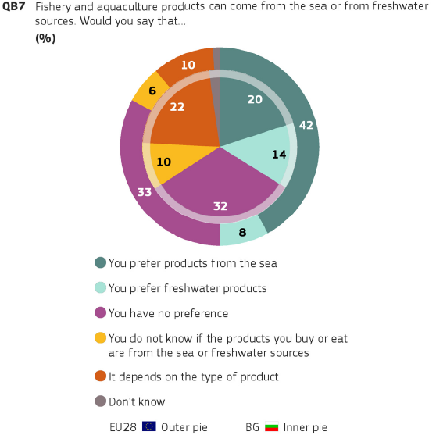
A relative majority of consumers prefer products from the sea (42%) to freshwater products (8%), while 33% have no preference
46% (19% in BG)
aged 55+ but in BG 32% 15-24
64% (34% in BG)
prefer wild products
51% (28% in BG)
prefer products from own region but,,,
Lead answer in 15 countries – NOT IN BG (no preference)
Base: respondents who buy and/or eat fishery or aquaculture products

Slide 17
Local and EU is largely preferred, but in Bulgaria a quarter of consumers have no preference (23%)
→Quality schemes largely used by retailers (PDO, PGI, local supply chains or traceability)
Base: respondents who buy fishery or aquaculture products

Slide 18
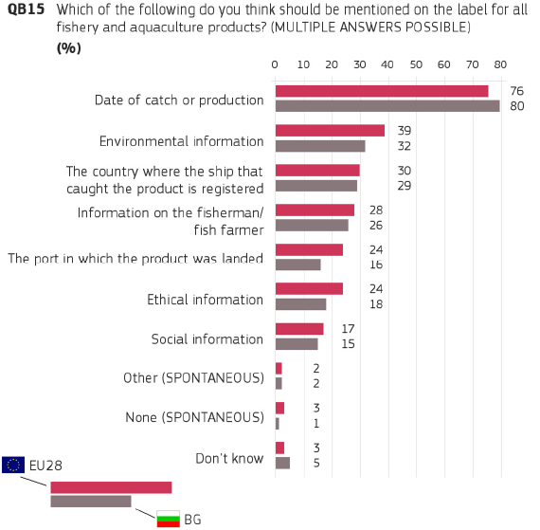
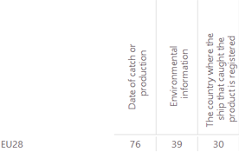
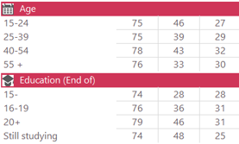
Interest in voluntary information
Eco-labels: large development over the last decade but no price premium
Base: respondents who buy and/or eat fishery or aquaculture products

Slide 19
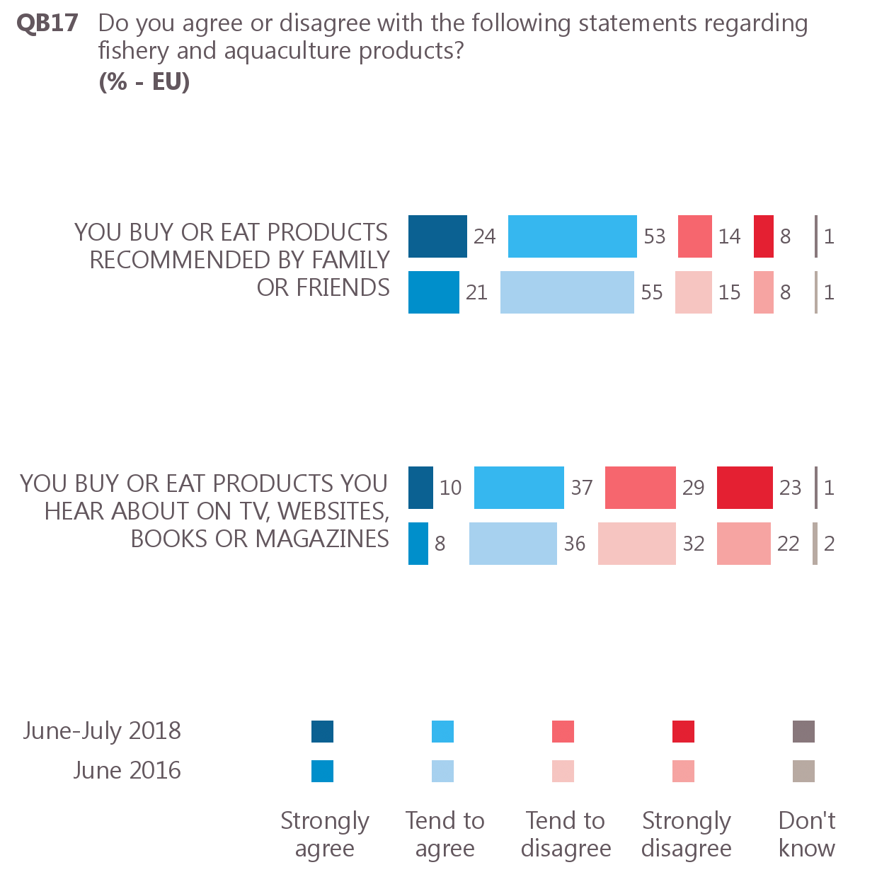
Consumers are more likely to follow suggestions from family and friends (86%) than from the media (44%)
38
48
8
5
1
12
32
26
26
4
Base: respondents who buy and/or eat fishery or aquaculture products

Slide 20
Thank you for your attention! http://ec.europa.eu/commfrontoffice/publicopinion/index.cfm/survey/getsurveydetail/instruments/special/surveyky/2206

