Slide 1





The EU in the world
EU market supply
.
.
-
.
.
.
.
The EU fish market
Edition 2018
Consumption
Trade
EU landings
Aquaculture production

Slide 2

The EU fish market
Scope and objectives
“The EU fish market” aims at providing a description of the whole European fisheries and aquaculture industry.
It replies to questions such as:
what is produced/exported/imported,
when and where,
what is consumed,
by whom and
what are the main trends.
A comparative analysis allows to assess the performance of fishery and aquaculture products in the EU market compared with other food products.
More detailed and complementary data are available in the EUMOFA database: by species, place of sale, Member State, partner country. Data are updated daily.
www.eumofa.eu

Slide 3

The EU in the world
World production in 2016
(1.000 tonnes)
Country | Fishery | Aquaculture | Total production | % total
China | 17.807 | 63.722 | 81.529 | 41%
Indonesia | 6.584 | 16.616 | 23.200 | 12%
India | 5.082 | 5.703 | 10.785 | 5%
Viet Nam | 2.786 | 3.635 | 6.421 | 3%
EU - 28 | 5.014 | 1.290 | 6.304 | 3%
USA | 4.931 | 444 | 5.375 | 3%
Russian Federation | 4.773 | 174 | 4.947 | 2%
Japan | 3.275 | 1.068 | 4.343 | 2%
Philippines | 2.028 | 2.201 | 4.229 | 2%
Peru | 3.812 | 100 | 3.912 | 2%
Bangladesh | 1.675 | 2.204 | 3.879 | 2%
Norway | 2.203 | 1.326 | 3.529 | 2%
Republic of Korea | 1.396 | 1.859 | 3.255 | 2%
Myanmar | 2.072 | 1.018 | 3.090 | 2%
Chile | 1.829 | 1.050 | 2.879 | 1%
Thailand | 1.531 | 963 | 2.494 | 1%
Others | 23.347 | 6.834 | 30.181 | 15%
Total | 90.145 | 110.207 | 200.352 | 100%
^{[1]} Eurostat does not include inland waters.
Globally, aquaculture production exceeds the share of fisheries on total production, thanks to farmed production in Asian countries.
By contrast, the EU accounts only for 1,2% of the global aquaculture production. This figure represents about 20% of its own domestic production.

Slide 4
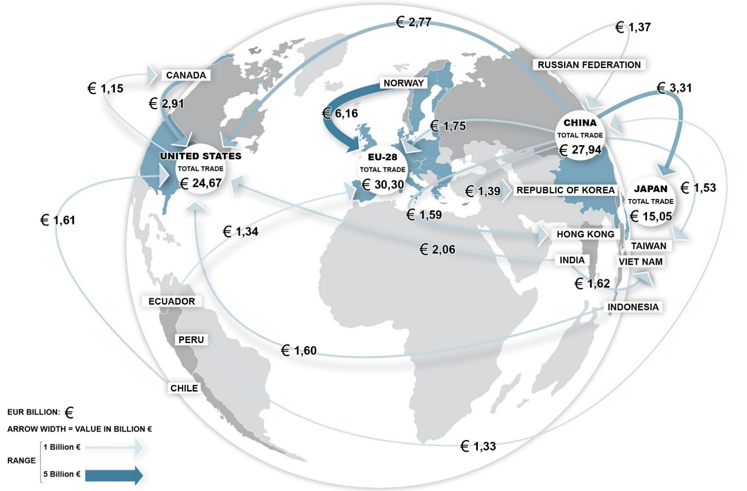
The EU in the world
Main trade flows in 2017
The EU is the top trader of fishery and aquaculture products in the world.
Salmon, cod, shrimps and tuna are the most imported products. On the other hand, the EU exports in particular salmon, tuna, mackerel and fishmeal.

Slide 5
The EU in the world
World consumption of seafood
(kg per capita)

Slide 6
EU market supply
.
.
-
.
.
.
.
Supply balance in 2016
After a 2,5% decrease from 2014 to 2015, the EU seafood supply increased by 450.000 tonnes in 2016 (+3,3%).
Production increased, but imports are the main driver (+4%, a 10-year peak).
Data provided in live weight equivalent deriving from the EUMOFA’s Supply balance sheet.

Slide 7
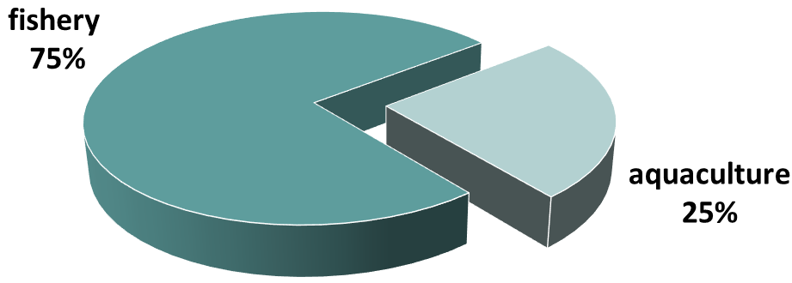
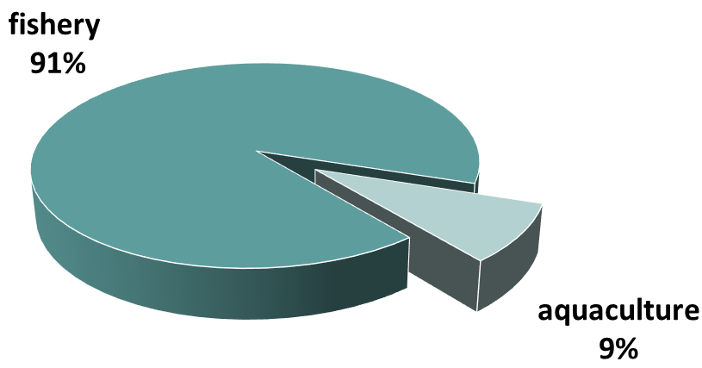
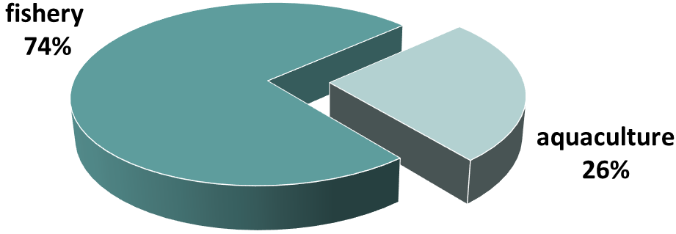
EU market supply
.
.
-
.
.
.
.
Production (food use)
In 2016, catches increased by 2%, marking a recovery from 2015’s 9% decrease. Aquaculture production increased as well by 2%, continuing the upward trend started in 2014.
Trade
In 2016, imports of both farmed and wild products increased by 4% each compared to 2015 while exports increased by 1%.
Import
Export
Apparent consumption
Consumption in the EU market is dominated by wild products, representing three-fourths of the total.
In 2016, 18,61 kg per capita of wild fish were consumed, while farmed products totalled 5,72 kg per capita.
fishery
76%
aquaculture
24%
Data provided in live weight equivalent deriving from the EUMOFA’s Supply balance sheet

Slide 8
EU market supply
.
.
-
.
.
.
.
EU market growth and self-sufficiency rates
The EU self-sufficiency rate, which is the ratio of domestic supply over domestic demand, decreased to 41,7% in 2016 compared to 2015.
This decrease was mainly due to a substantial increase of imports which was much more intense than that registered for farmed and wild EU production.
Data provided in live weight equivalent deriving from the EUMOFA’s Supply balance sheet

Slide 9

Consumption
Per-capita consumption of fish and seafood per Member State
(kg per capita in 2016 and % variation 2016/2015)
Portugal has continued to have the highest per capita consumption of fishery and aquaculture products since 2001, although it contracted slightly, from 57,5 kg in 2001 to 57 kg in 2016.

Slide 10
Consumption
Apparent consumption of most important species
(2016)
Products | Per capita (kg) | % wild | % farmed
Tuna | 2,78 | 99% | 1%
Cod | 2,33 | 100% | 0%
Salmon | 2,19 | 5% | 95%
Alaska pollock | 1,59 | 100% | 0%
Shrimps | 1,56 | 62% | 38%
Mussel | 1,27 | 20% | 80%
Herring | 1,23 | 100% | 0%
Hake | 0,96 | 100% | 0%
Squid | 0,72 | 100% | 0%
Sardine | 0,69 | 100% | 0%
Mackerel | 0,58 | 100% | 0%
Surimi | 0,58 | 100% | 0%
Freshwater catfish (including pangasius) | 0,50 | 1% | 99%
Trout | 0,42 | 1% | 99%
Scallop | 0,35 | 84% | 16%
Others | 6,59 | 84% | 16%
Total | 24,33 | 76% | 24%
Tuna (mostly canned) remained the most consumed species in the EU
Tuna, cod and salmon accounted for 30% of total consumption.
.
Data provided in live weight equivalent deriving from the EUMOFA’s Supply balance sheet

Slide 11
Consumption
Organic fish consumption
(1.000 tonnes)
Since 2013, the consumption of organic fish and seafood products has been constantly increased by 49%, registering almost 45.000 tonnes in 2016.
Of the five most relevant countries, only Italy shows a relatively stable level of consumption.

Slide 12
Consumption
EU quality schemes in the seafood sector
(2018)
 | Unprocessed | Processed | Unprocessed/ Processed | Total | % of total
Fishery | 8 | 16 | 5 | 29 | 57%
Aquaculture | 15 | 1 | 5 | 21 | 41%
Fishery / Aquaculture | 0 | 1 | 0 | 1 | 2%
Total | 23 | 18 | 10 | 51 | 100%
% Total | 45% | 35% | 20% | 100%
51 products are registered with EU quality schemes in the seafood sector.
Two-thirds of the products (34) are PGIs, 14 are PDOs, and 3 are TSGs.
29 are fishery products (19 different species), 21 are aquaculture products (mainly carp, mussel, salmon and oyster) and one product (processed) may use fishery or aquaculture product (PGI “London Cure Smoked Salmon”).

Slide 13
Trade
Structure of extra-EU trade of fishery and aquaculture products
The EU trade balance deficit of FAPs has been rising since 2013. Despite exports reaching a 13-year value peak in 2017, the deficit also reached a negative peak. Compared with 2016, the deficit increased EUR 558 million or 3% in 2017, reaching a total of EUR 20,2 billion.

Slide 14
Trade
Extra-EU imports growth and ratio of imported fish value vs. meat
In 2017, fish represented 18% of the overall EUR 143 bln worth of food products imported by the EU.
The EU imported more than 5 times more fish than meat in 2017 in value.

Slide 15
Trade
EU trade flows of fisheries and aquaculture products
EU trade, which encompasses trade flows with extra-EU countries and exchanges between Member States, has been increasing since 2010 with an average annual growth rate of 6%.
In 2017, the total value of trade flows amounted to EUR 57 bln (+ EUR 2,6 bln from 2016).

Slide 16
Trade
Extra-EU imports of fisheries and aquaculture products
In 2017, extra-EU imports of FAPs declined a slight 1% from the peak reached the previous year and totalled 5,9 million tonnes. However, they were 106.000 tonnes above their 10-year average.
The 3 main importing countries are Sweden, Denmark and Spain.
More than one quarter of EU imports originates from Norway, followed at distance by China.

Slide 17
Trade
Extra-EU exports of fisheries and aquaculture products
In 2017, the total value of fisheries and aquaculture products exported by the EU to third countries reached a 10-year peak at over EUR 5 billion.
In terms of volume, a recovery was observed with a 6% grow over 2016 (but still 178.190 tonnes less than the 10-year peak of in 2014).
Salmon remains the most valued “main commercial species” exported by the EU. Exports grew by 11% over 1 year and 64% over 5 years.
EU exports are mainly destined to Nigeria and Norway in volumes and to the US and China markets in value.

Slide 18
Trade
Intra-EU trade of fisheries and aquaculture products
Almost half of fish products traded consists of exchanges between Member States. Intra-EU trade has been growing since 2009, at average annual growth rates of 3% in volume and 7% in value. In 2017, they reached 6,5 million tonnes and EUR 26,7 billion. All MCS are exchanged within the EU. After salmonids, groundfish are the second most valued commodity group traded, with cod as the main commercial species.

Slide 19
EU landings
Total landings in the EU
In 2016, volumes of fish landed in the EU (including species not destined for human consumption and seaweed) reached 4,3 mln tonnes. This represented a decrease of 7% from 2015. Conversely, a 5% increase was recorded in values, reaching EUR 7,38 billion.
Almost all landings in the EU were made by EU vessels (97% of volume, 99% in value).
The most landed species (80% in volume) in the EU belong to four commodity groups: small pelagics, groundfish, tuna and tuna-like species, and the grouping “other marine fish.” Only landings of tuna and tuna-like species increased in 2016.
The three main countries are Spain, France and the UK in value and Denmark, Spain and the UK in volume.

Slide 20


Aquaculture production
Total aquaculture production in the EU
In 2016, fish products farmed in the EU reached the highest values ever registered. The total value of EUR 4,25 bln representing a 4% increase from 2015.
Volumes also reached an all-time peak, totalling 1,29 mln tonnes (+2%).
The three main countries are Spain, UK and France.

Slide 21
Aquaculture production
Composition of farmed species in the EU
(in value)
Around 95% of total EU aquaculture production is represented by 10 species. Compared to 2007, the most significant changes recorded in value terms. Volumes are pretty comparable. The increased production of salmon and European seabass offset the declining trend registered for oyster, clam, trout and mussels.

Slide 22
Final remarks
In this report …
Slight increase in consumption of seafood in the EU and contraction of self-sufficiency
Importance of wild seafood supply
Higher prices and increasing expenditure of the EU households for purchasing fish
Expenditure for fish compared with meat
Pivotal role of the EU in the global fish and seafood trade
Increasing value of landings and aquaculture production in the EU
Macroeconomic trends: inter alia evolution of marine fuel prices
An obligation
But more importantly a cooperation to our mutual benefit
Importance of contributions from MS

Slide 23
THANK YOU FOR YOUR ATTENTION
http://www.eumofa.eu/the-eu-fish-market

